Slide 1


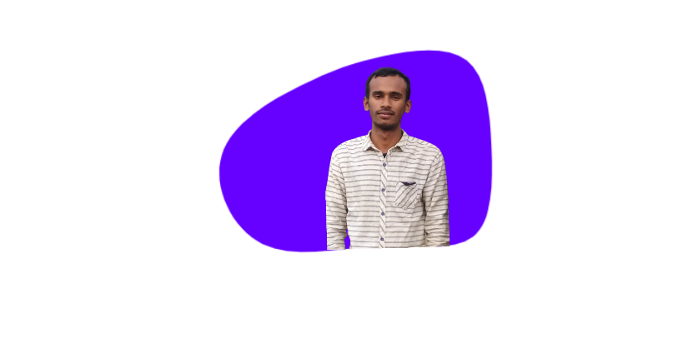





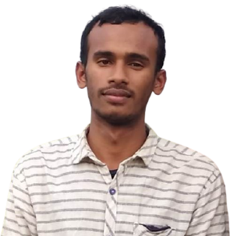









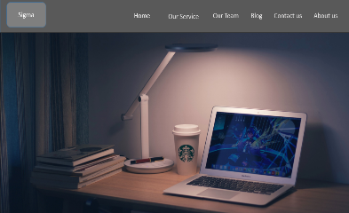
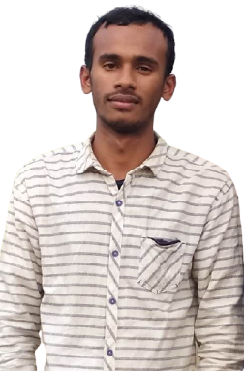




Pobarul Islam
Services
Contact me
Home
About
Skills
Portfolio
Hi, I 'am Pobarul Islam
Frontend developer
High level experience in web design and
development knowledge,
Producing quality work.
Contact me
Scroll down
About Me
My introduction
Web developer, with extensive knowledge
And years of experience, working in web
Technologies and Ui/Ux design, delivering
Quality work.
01+
Years
experience
10+
Completed
projects
01+
Companies
worked
Download cv
Skills
My technical level
Frontend developer
More than 2 years
Backend developer
More than 2 years
HTML
95%
PHP
95%
CSS
97%
Node js
97%
Java Script
90%
Firebase
90%
React
93%
Python
93%
Designer
More than 1 years
Figma
97%
Sketch
97%
Photoshop
90%
Education
Qualification
My personal journey
Work
General Electrical works
Horinmari Technical school
2020 - Present
Web design
Serve human foundation
2021 - Present
Web design & development
Serve human Foundation
2021 - Present
Frontend developer
Serve human foundation
2020 - Present
Services
What i offer
Digital
Marketer
Frontend
developer
Backend
developer
View More
View More
View More
Portfolio
Most recent work
Modern website
Website adaptable to all device, with
ui components and animated
Interaction.
Demo
You have a new project
Contact me now and get 30% discount on your
New project .
Contact me
Testimonial
My client saying
Abul hassan
Client
Shilpi islam
Client
I get a good impression, I carry out my
project with all the possible quality and
Attention and support 24 hour a day .
I get a good impression, I carry out my
project with all the possible quality and
Attention and support 24 hour a day .
Contact Me
Get in touch
Call Me
+8801721620738
Name
Email
Email
pobarul3@gmail.com
Project
Location
Thakurgaon sador-5102 ,
Rangpur, Bangladesh
Message
Send Message
Pobarul islam
Services
Portfolio
Contact Me
Frontend developer
Pobarul islam. All right reserved

